Slide 2
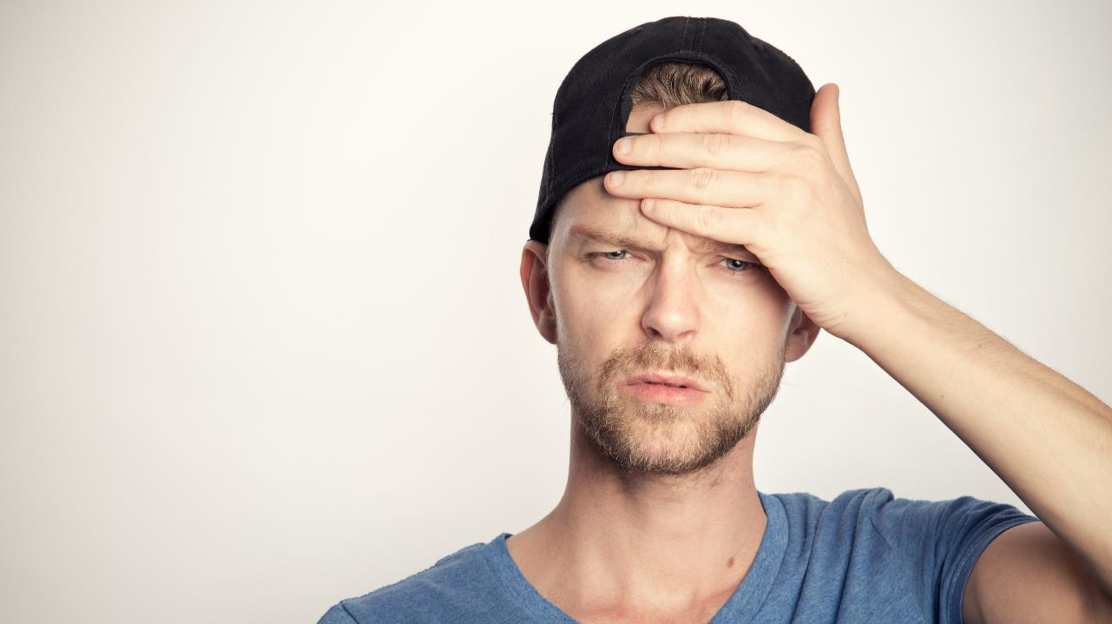
Why am I here?
Dealing with Imposter Syndrome
Notes:
Photo by Sander Sammy on Unsplash
This is the session title, hopefully you are in the right place?

Slide 3
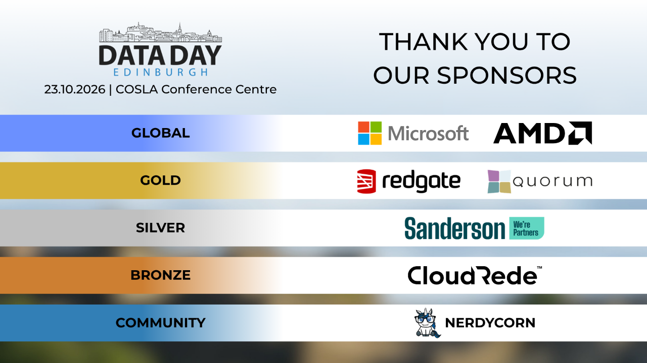

Slide 4

https://xkcd.com/1954/
Notes:
Thought it would be a nice way to start the session

Slide 5

Notes:
Photo by Daniel Schludi on Unsplash
Let me start this session with a story

Slide 6

Notes:
Many years ago
SQL Grill had new speaker track
Never spoken at technical conferences and wanted to speak

Slide 7

Notes:
Photo by AbsolutVision on Unsplash
Thought this would be really good for a friend of my to submit to the conference
They might have a different idea!

Slide 8

Notes:
Photo by Cytonn Photography on Unsplash
Made a deal if he submitted I would submit

Slide 9

Notes:
Photo by DS stories: https://www.pexels.com/photo/word-never-combined-of-scrabble-tiles-6005514/
Confident that my sessions would not get picked

Slide 10
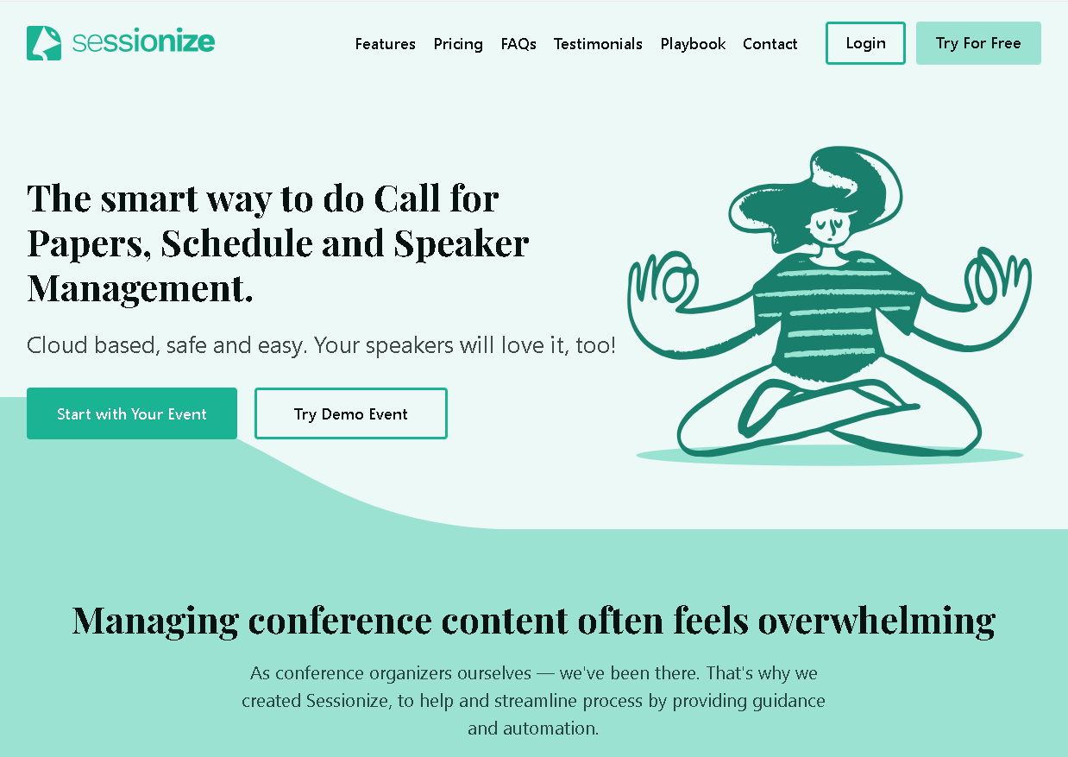
Notes:
So we submitted the sessions, I was confident they would never be picked

Slide 11

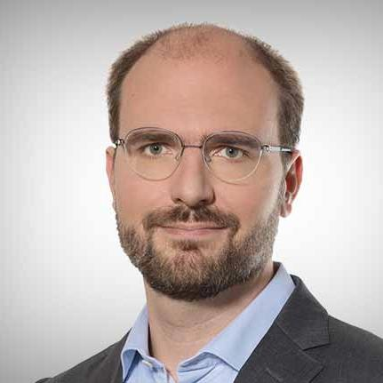
Notes:
William Durkin and Ben Wiessman had other ideas

Slide 12

Notes:
Photo by Miguel Á. Padriñán: https://www.pexels.com/photo/close-up-shot-of-keys-on-a-red-surface-2882686/
The selection committee said Yes !

Slide 13

Notes:
Photo by Andrey Metelev on Unsplash
So I panicked

Slide 14

Notes:
Photo by John Schnobrich on Unsplash
So I started planning my presentation

Slide 15
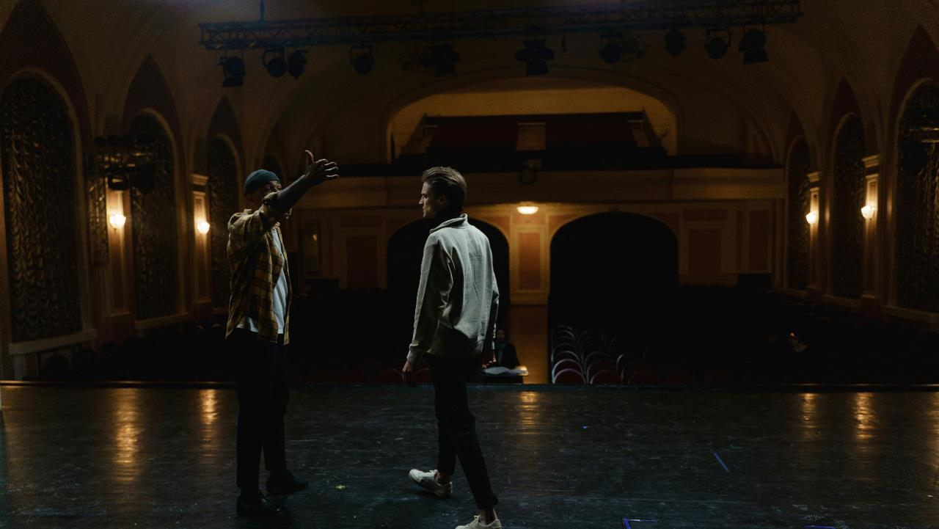
Notes:
Photo by cottonbro studio: https://www.pexels.com/photo/two-men-acting-on-stage-6896333/
So rehearsed,
Then rehearsed,
Then rehearsed and rehearsed

Slide 16

Notes:
Photo by Gianandrea Villa on Unsplash
Whilst doing my rehearsals I recorded some of the sessions

Slide 17
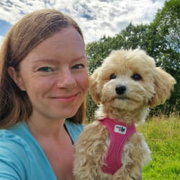
Notes:
Catherine asked me to send here a my session recording so should could give me some pointers

Slide 18

Notes:
Photo by Donald Tong: https://www.pexels.com/photo/person-doing-thumbs-up-193821/
Catherine was very kind and said keep doing what you are doing
She sent a tweet on Twitter as it was then
Saying that I’ve seen my mentees session you are in for a treat

Slide 19

Notes:
Photo by Lee Myungseong on Unsplash
At the speakers dinner again I felt like an imposter, yet so many people where very kind, and some said they were looking forward to my session.

Slide 20
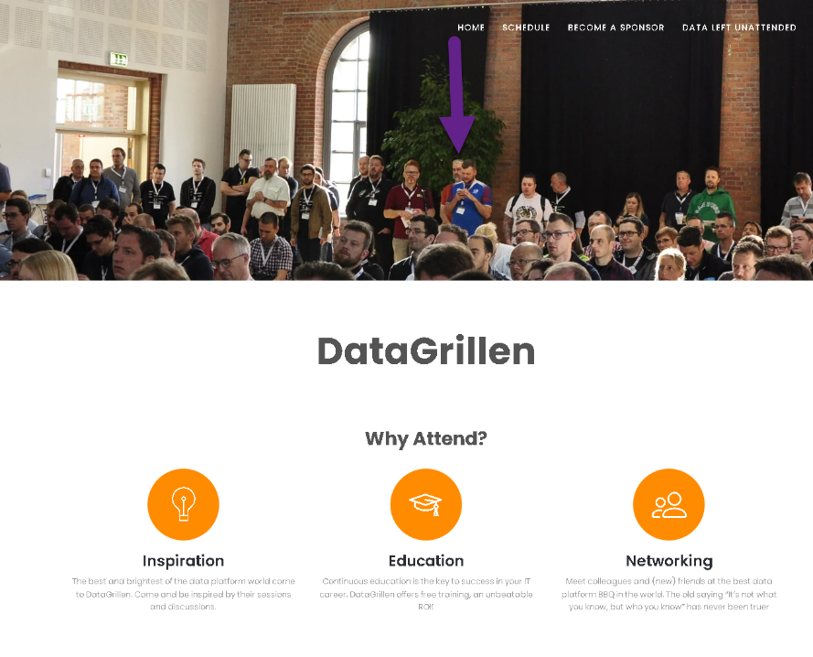

Slide 21

Notes:
Photo by Annie Spratt on Unsplash

Slide 22

Notes:
Photo by Yasser Mutwakil ياسر متوكل on Unsplash
In the speakers lounge I felt unworthy

Slide 23
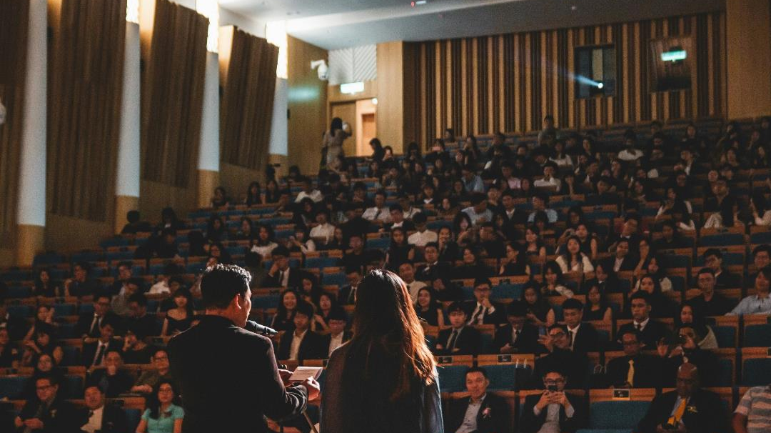
Notes:
Photo by Wan San Yip on Unsplash
When it came to my session I was shocked to see people had turned up to my session !

Slide 24
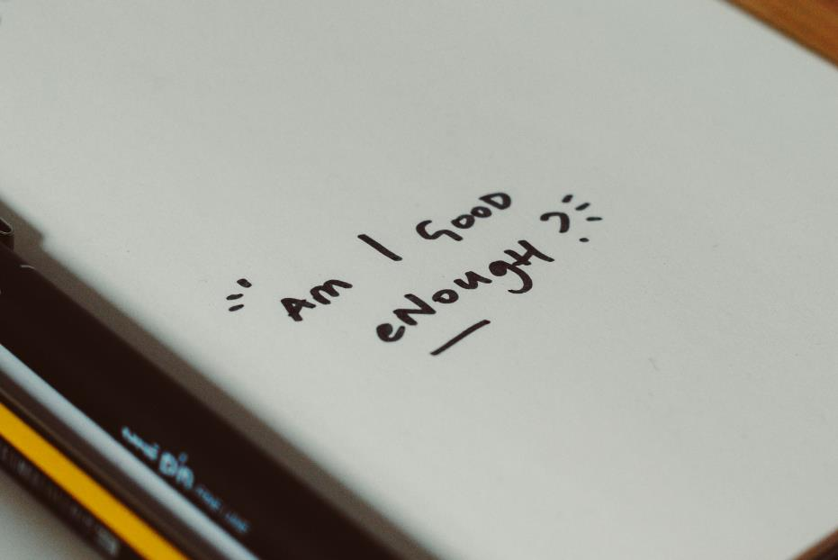
Notes:
Photo by Nik on Unsplash
I did not feel good enough to hear the compliements

Slide 25
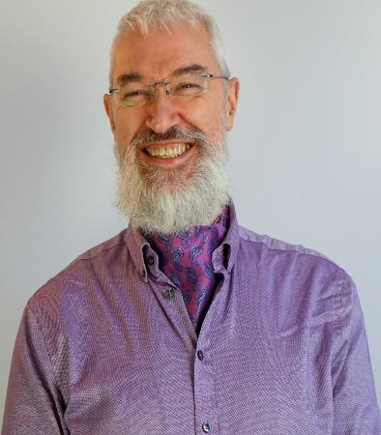




Robert French
Chief Power BI Nerd with ANS Group
Lives in Sunny Glasgow, Scotland
rwlp.french@gmail.com
@sqlbobscot
https://www.linkedin.com/in/rwlpfrench/
https://www.ans.co.uk/

Slide 26

Notes:
Photo by Immo Wegmann on Unsplash
What is the goal of this session

Slide 27
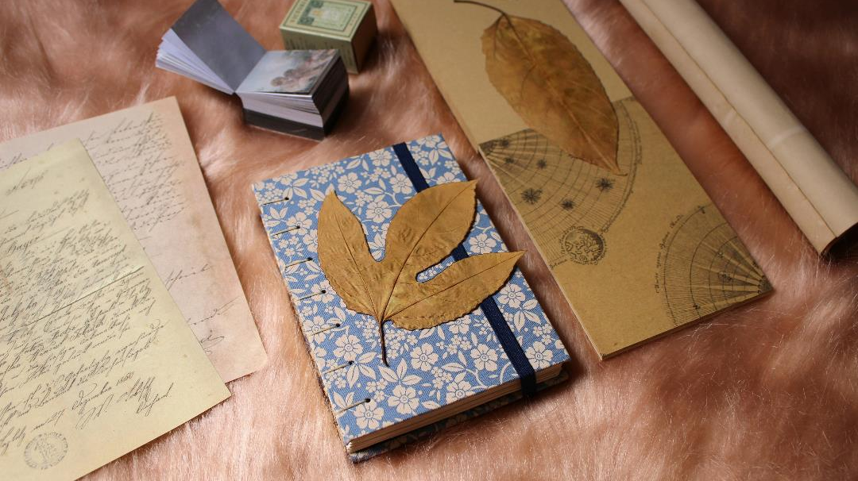
Notes:
Photo by melanfolia меланфолія on Unsplash
This is just my thoughts and ideas
I’m not a professional if you recognise yourself in any of this please ask for help if you think you need it

Slide 28
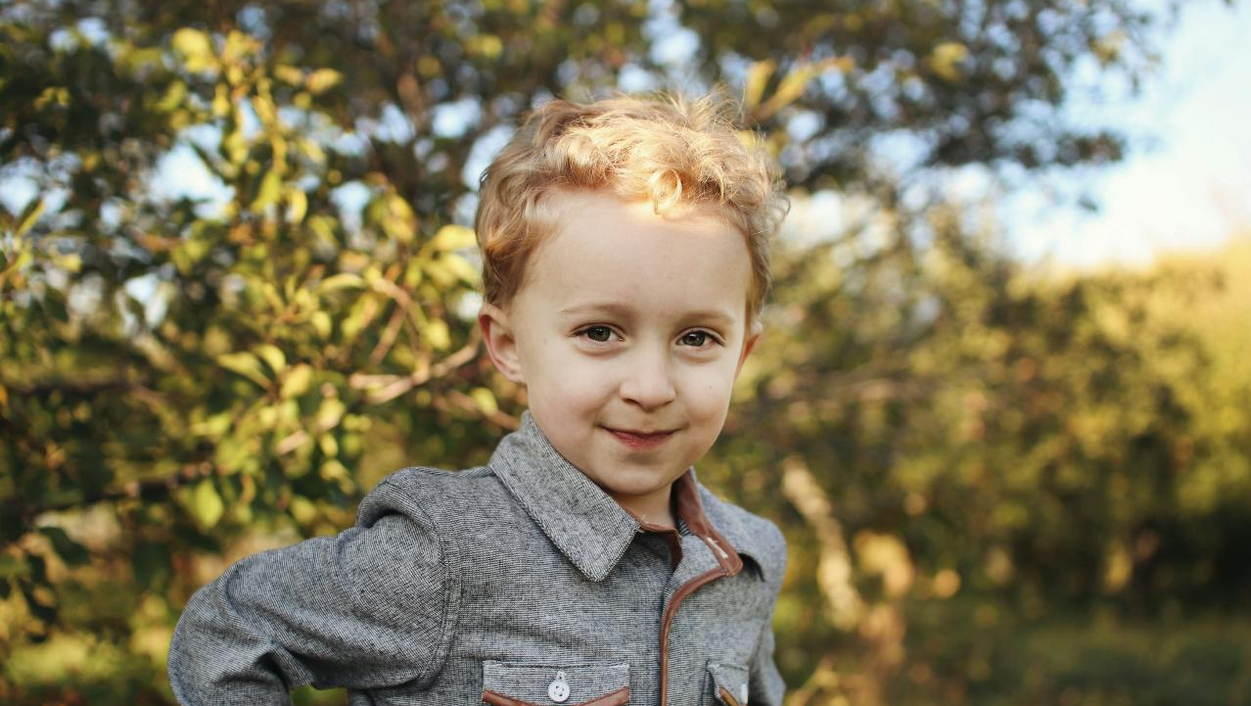
Notes:
Photo by Jen Theodore on Unsplash
This is what I would want to say to younger me

Slide 29
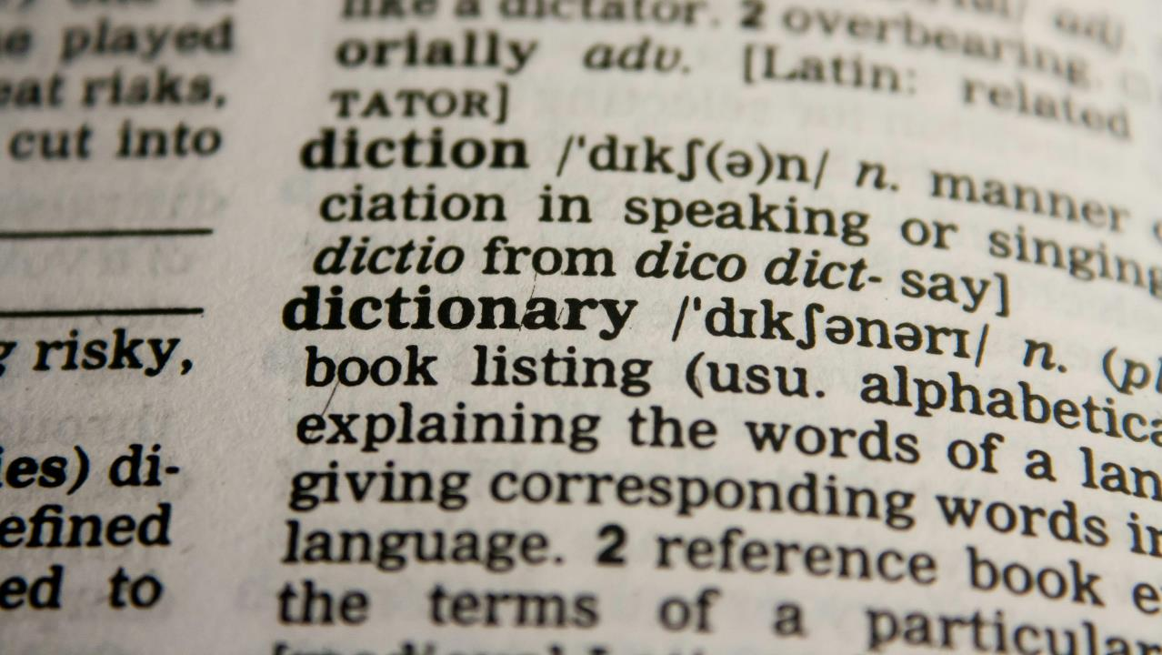
Notes:
Photo by Pixabay: https://www.pexels.com/photo/dictionary-text-in-bokeh-effect-267669/
Lets define it

Slide 30
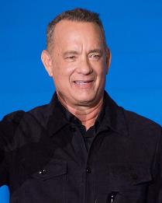
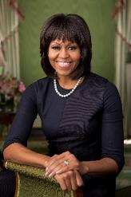
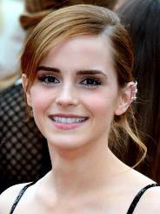
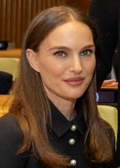

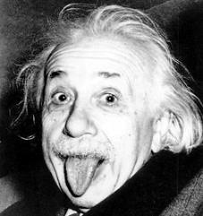
Notes:
Lets look at some people who have imposter syndrome

Slide 31
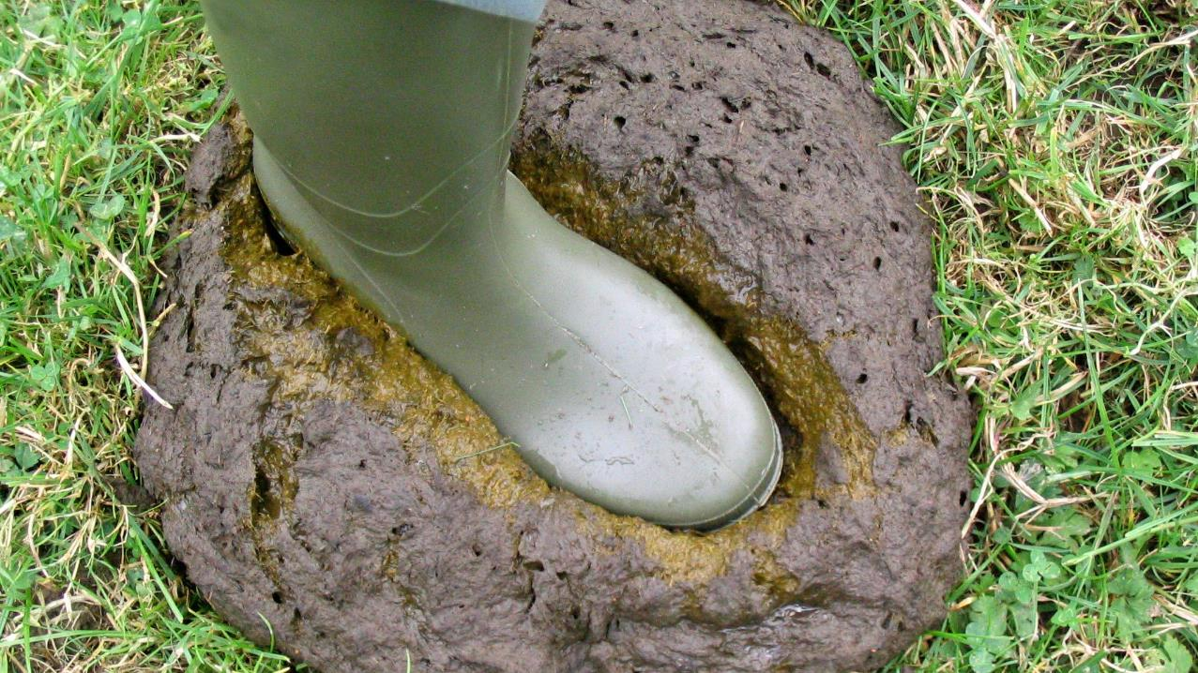
Notes:
https://www.flickr.com/photos/joysaphine/2445439236
Dealing with Bull Shit Bob

Slide 32

Notes:
Photo by engin akyurt on Unsplash
Living with it
What kind of impact does it have on my life?

Slide 33
Compliments

Slide 34
Find out more

Slide 35
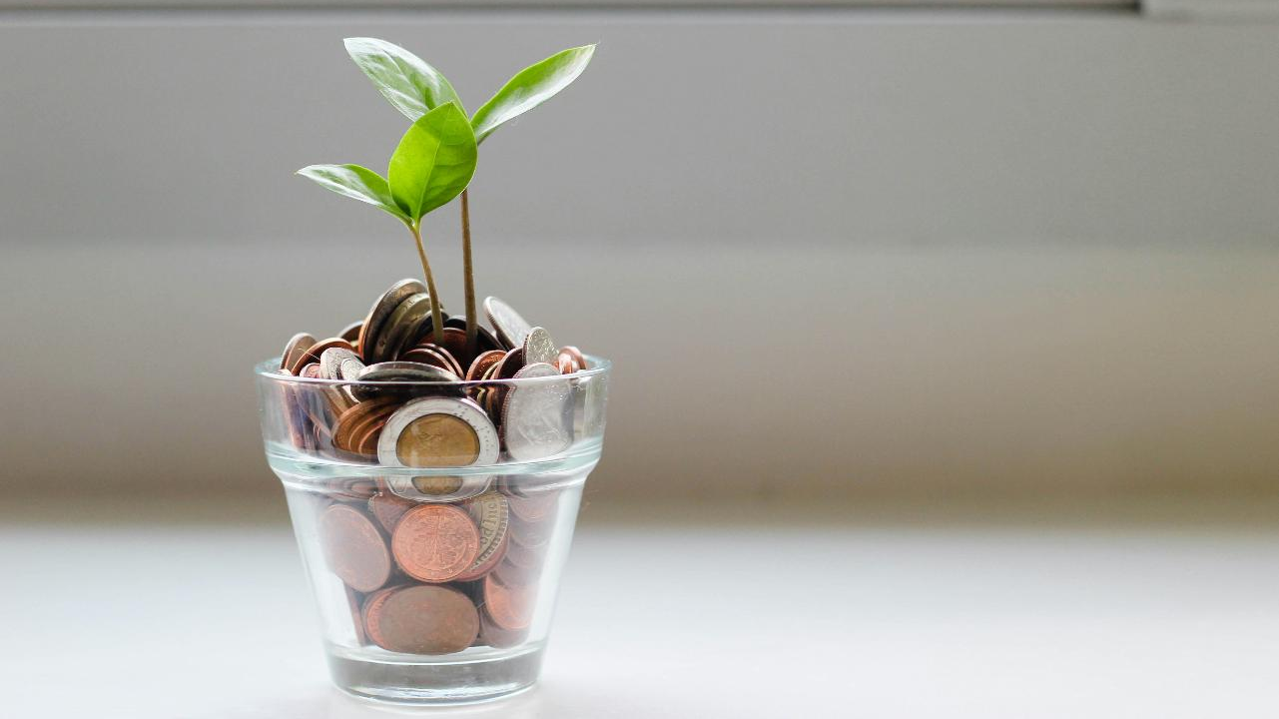
Notes:
Photo by micheile henderson on Unsplash

Slide 36
Notes:
Photo by Pixabay: https://www.pexels.com/photo/dictionary-text-in-bokeh-effect-267669/
Lets define it

Slide 37
Also know as
Impostorism
Impostor Phenomenon
Fraud Syndrome

Slide 38

Notes:
Photo by LinkedIn Sales Solutions on Unsplash
History of imposter syndrome
Goes back to the 1970 before the phrase was thought of
Psychologists Pauline Rose Clance and Suzanne Imes
Found both shared that despite academic success had feeling of self doubt and questioned their abilities
Sounds familiar
Spoke to other successfully women and heard similar experiences

Slide 39
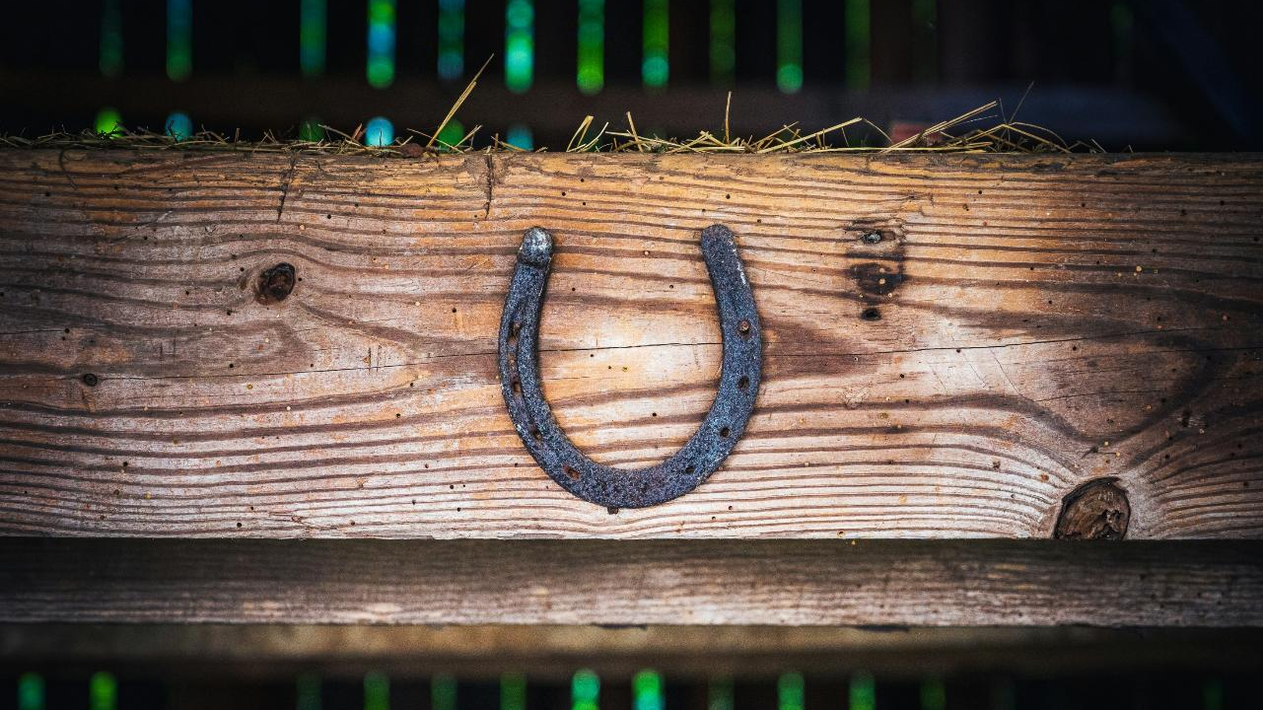
Notes:
Photo by Matt Benson on Unsplash
Many thought they had got in to the course by luck

Slide 40
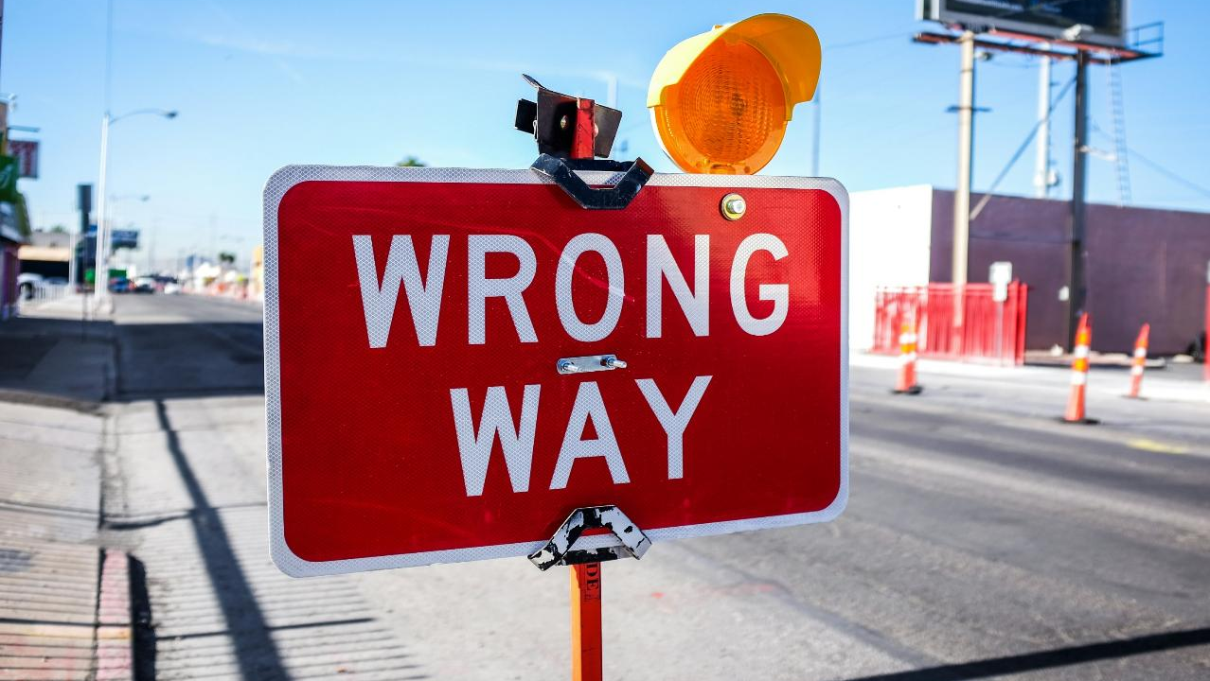
Notes:
Photo by Quilia on Unsplash
They got intpo the course by mistake

Slide 41
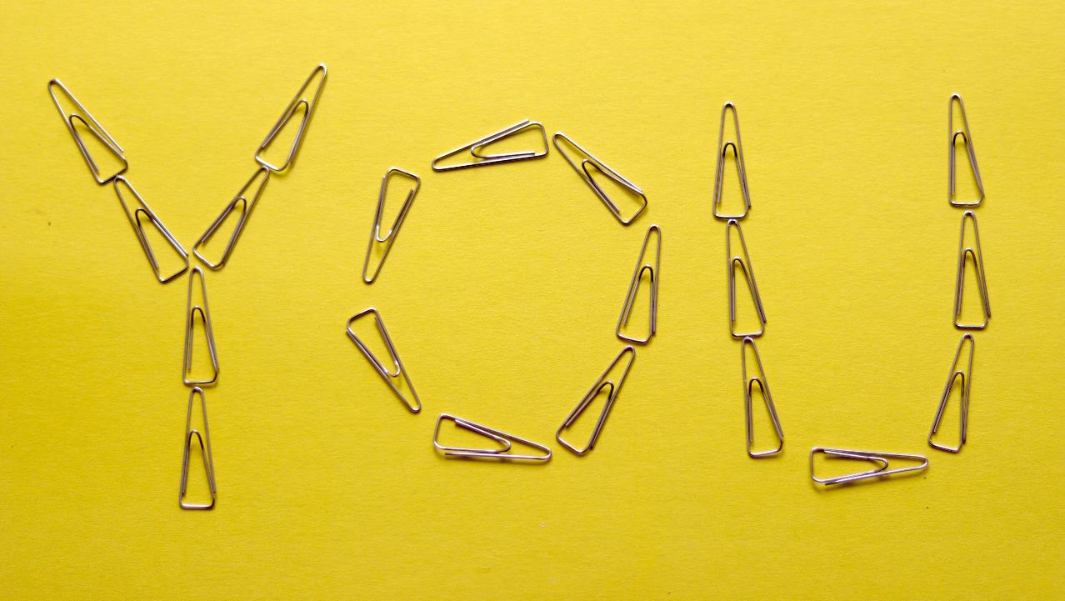
Notes:
Photo by Ben Robbins on Unsplash
Lets talk about you

Slide 42

Notes:
Photo by Lisa Fotios: https://www.pexels.com/photo/person-holding-iphone-1322360/
Lets look at at the different ways imposter syndrome is expressed
Ask yourself do you any of these describe you?

Slide 43

The Perfectionist
Notes:
Photo by Karolina Kaboompics: https://www.pexels.com/photo/typed-message-on-pink-paper-5993378/
Perfectionist
Do you struggle to delegate tasks to others?
Do you feel you must get 100% perfect 100% of the time?
If you miss out on an high score or not get amazing feed back, do you
Consider you are not cut out for that job?
Think about it for days? How you can do better?

Slide 44
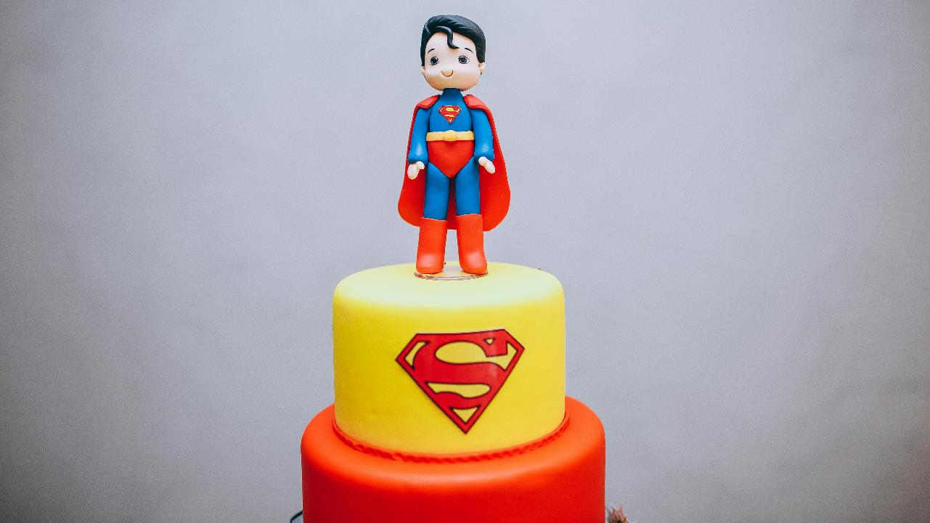
Superwoman or Superman
Notes:
Photo by Helena Lopes: https://www.pexels.com/photo/a-superman-themed-birthday-cake-10336820/
Superwomen / man
Do you stay later than your team, even if completed all the work that day?
Do you get stressed when not working, finding downtime wasteful?
Have you let hobbies and pastimes drop, as they are scarified for work?
Do you feel that you have not earned your title and feel pressured to work harder and longer than others.

Slide 45
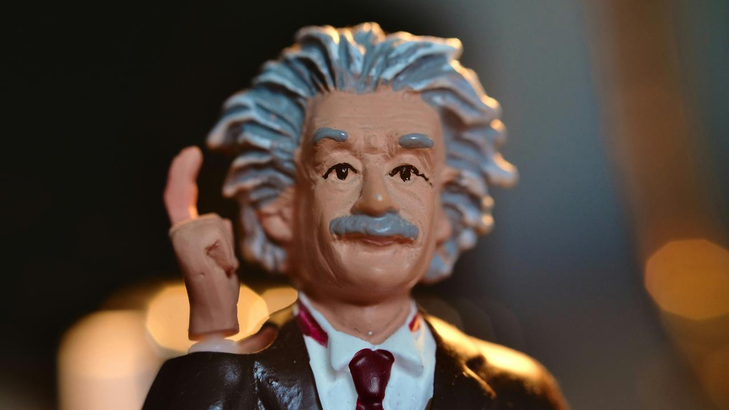
The Natural Genius
Notes:
Photo by Andrew George on Unsplash
The Natural Genius
Do you excel without much effort?
Do you dislike the idea of a mentor because you can handle things on your own?
Does your confident fall when you not preforming well?
Do you avoid challenges because you are uncomfortable trying something you are not good at?

Slide 46
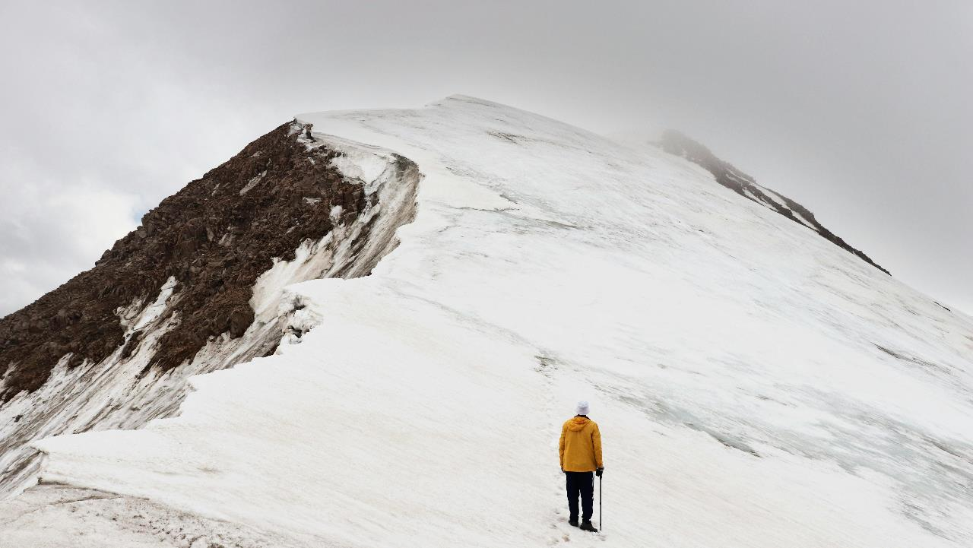
The Soloist
Notes:
Photo by Yevgeniya Fedorova: https://www.pexels.com/photo/man-climbing-snow-covered-hill-1327350/
The soloist
Do you believe you can do anything on your own?
“You do not need anyones help”
Do you frame requests for help in terms of project requirements?

Slide 47

The Expert
Notes:
Photo by Austin Distel on Unsplash
The expert
Only apply for jobs if you meet all the requirements exactly
Constantly looking new certifications or training to improve your skills
Shudder when someone calls you an expert

Slide 48
Notes:
Photo by Lisa Fotios: https://www.pexels.com/photo/person-holding-iphone-1322360/
Did you recognise yourself?
I see a lot of myself in each one!

Slide 49
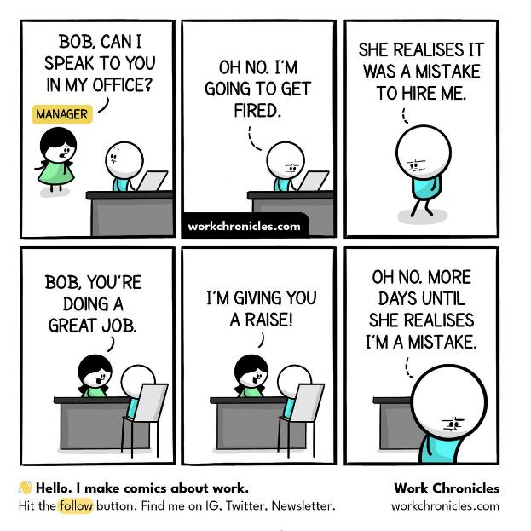
Notes:
This cartoon I relate to only too well this is how I felt more than once !

Slide 51
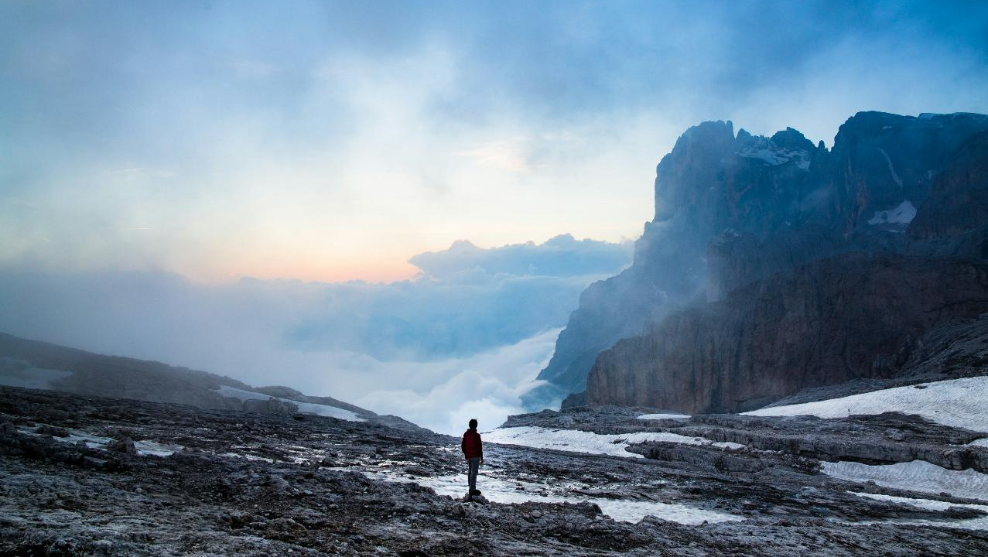
Notes:
Photo by Luca Baggio on Unsplash
Its only too easy to feel with imposter syndrome that you are the only person that experiences these feelings

Slide 52
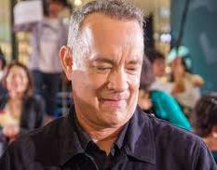
Tom Hanks
Notes:
https://commons.wikimedia.org/wiki/File:Sully_Japan_Premiere_Red_Carpet-_Tom_Hanks_%2829747825731%29.jpg
No matter what we've done, there comes a point where you think, 'How did I get here? When are they going to discover that I am, in fact, a fraud and take everything away from me?
https://www.npr.org/2016/04/26/475573489/tom-hanks-says-self-doubt-is-a-high-wire-act-that-we-all-walk

Slide 53
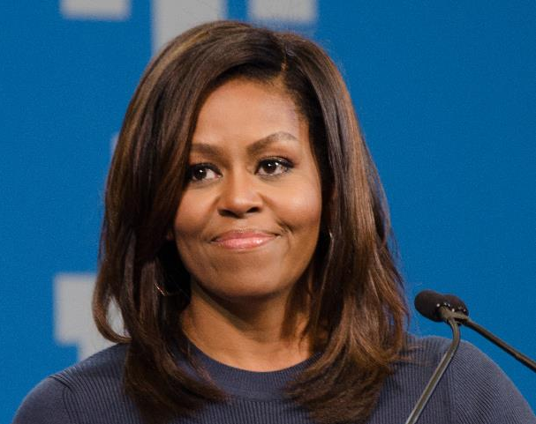
Michelle Obama
Notes:
It doesn't go away, that feeling that you shouldn't take me that seriously.
What do I know?
I share that with you because we all have doubts in our abilities, about our power and what that power is.
https://www.bbc.co.uk/news/uk-46434147

Slide 54
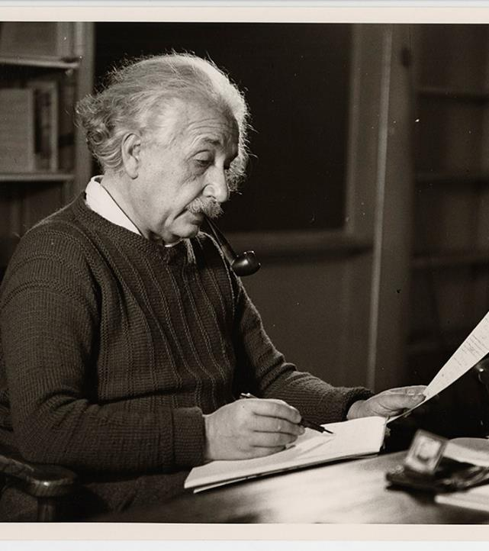
Albert Einstein
Notes:
The exaggerated esteem in which my lifework is held makes me very ill at ease.
I feel compelled to think of myself as an involuntary swindler.
https://www.nature.com/articles/529438a

Slide 55

Emma Watson
Notes:
“It’s almost like the better I do, the more my feeling of inadequacy actually increases, because I’m just going, ‘Any moment, someone’s going to find out I’m a total fraud, and that I don’t deserve any of what I’ve achieved.”

Slide 56
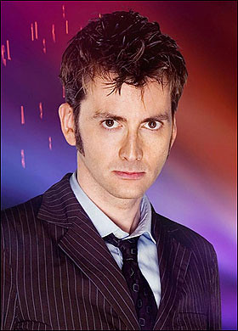
David Tennant
Notes:
It’s worrying about not being good enough, about being found out, about not being worthy as an actor.
http://davidtennantontwitter.blogspot.com/2019/05/0526ST.html

Slide 57
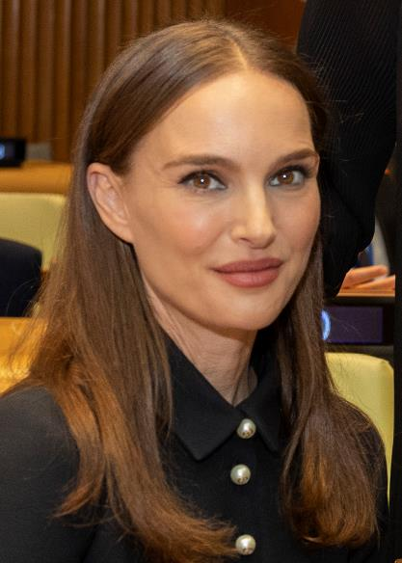

Natalie Portman
Notes:
“Today I feel much like I did when I came to Harvard Yard as a freshman in 1999,” she told the students who had gathered to listen to her. “I felt like there had been some mistake, that I wasn’t smart enough to be in this company, and that every time I opened my mouth I would have to prove that I wasn’t just a dumb actress.”

Slide 58
There are
many more……
Notes:
There even more within the data community
That also suffer from imposter syndrome
Scott Hanselman

Slide 59
Notes:
https://www.flickr.com/photos/joysaphine/2445439236
Dealing with Bull Shit Bob

Slide 60


Slide 61
Who is he?

Slide 62
What does he say?

Slide 63
When do I hear him the most?

Slide 64

Notes:
Photo by Henry Hustava on Unsplash
So how do I defend myself against Bullshit Bob?

Slide 65

Notes:
Photo by Borta: https://www.pexels.com/photo/black-microphone-in-light-conference-hall-4331578/
Scientific basis for self talk
Choose to re-frame your internal and external dialogue about you
Visualising situations

Slide 66

Notes:
Photo by John Arano on Unsplash
Self-talk has become one of my strengths.
Its not easy and it requires practice

Slide 67
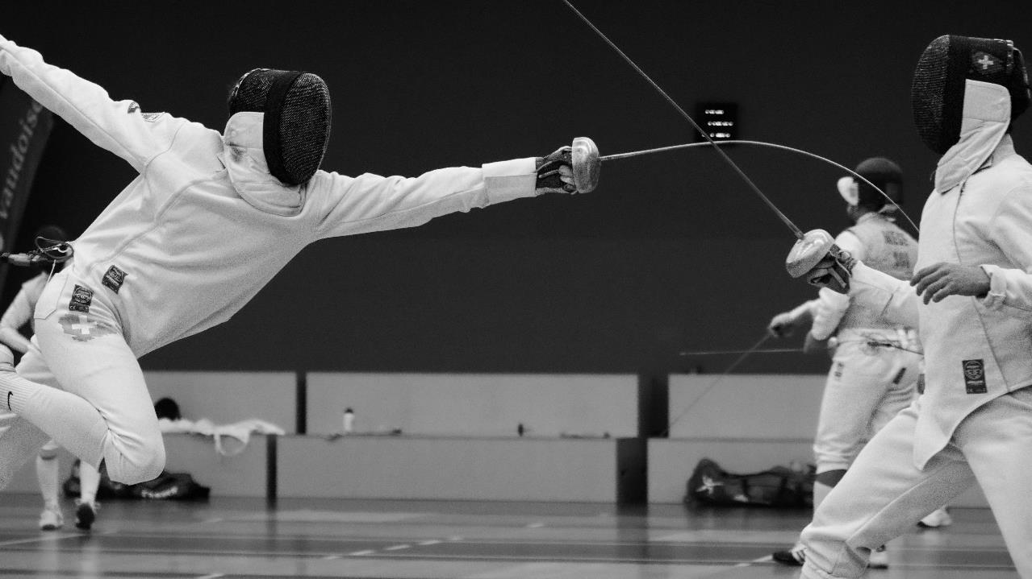
Notes:
Photo by Nathanaël Desmeules on Unsplash
Sometimes I have to reframe the way I talk about situations and events
On one side I have bull shit bob saying one thing
On the other side I have to reframe the situation to get a more positive way of looking at things

Slide 68
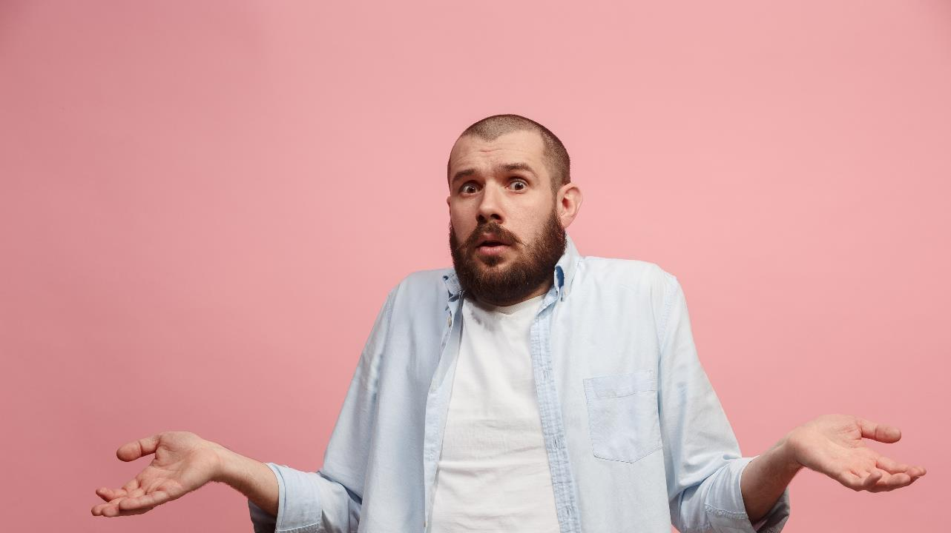
Notes:
So what do I mean by negative self talk?
Let me show you some examples

Slide 69
Negative self talk
“I know nothing about that new technology so I should just avoid it.”

Slide 70
Positive self talk
“What a fantastic chance to learn a new technology, I’m looking forward to it.”
Notes:
Yes you might be scared about learning something new, lots more to learn
Embrace the fear

Slide 71
Negative self talk
“I always make mistakes,
I should not even try.”

Slide 72
Positive self talk
“Yes, I sometimes make mistakes. Each mistake gives me a chance to learn.”
Notes:
Yes you might be scared about learning something new, lots more to learn
Embrace the fear

Slide 73
I
Identify
C
Confront
E
Extinguish

Slide 74

Notes:
Photo by Ann H: https://www.pexels.com/photo/photo-of-cubes-with-letters-forming-the-word-repeat-15380264/
For me to use positive self-talk I have to repeat and practice it every day

Slide 75
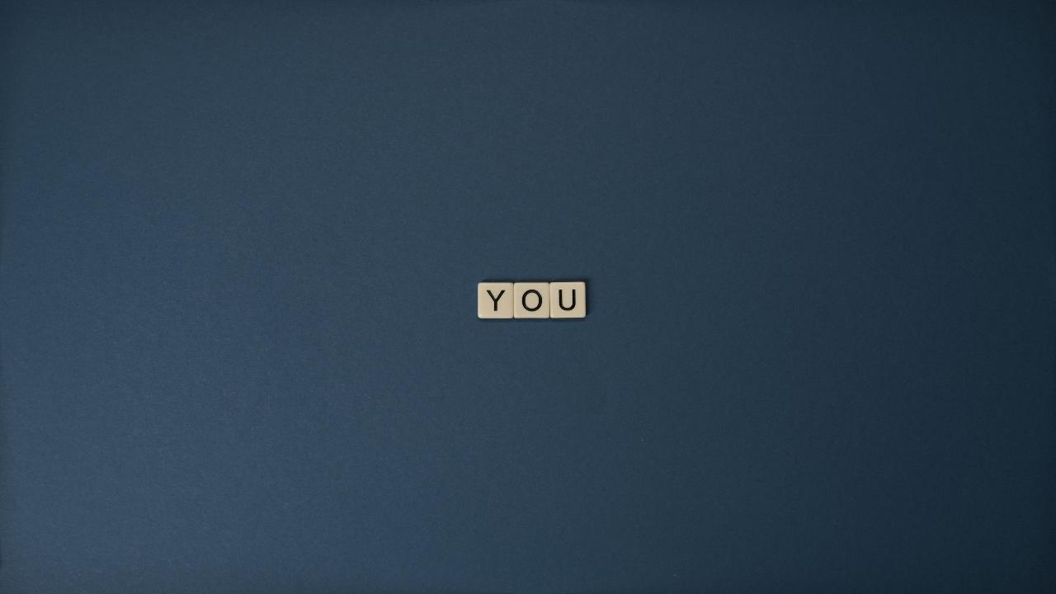
Notes:
Photo by Tima Miroshnichenko from Pexels: https://www.pexels.com/photo/close-up-shot-of-text-on-a-blue-surface-5912741/
This has been about what I do how can you help?

Slide 76

Notes:
Photo by UK Black Tech on Unsplash
In a meeting with colleagues listen to what is being said

Slide 77
They might say.
“I just got lucky with this project solution…..”
Notes:
They think that its just luck that delivered the solution they found

Slide 78
You could say.
“Luck give you the challenge, but you had the technical skills that solved it.”
Notes:
If you recognise that they delivered the solution through their technical ability tell them

Slide 79
They might say.
“I’m not ready to lead that technical topic….”
Notes:
Sometimes lack of confidence makes it hard to take that next step. They feel that need to know everything.

Slide 80
You could say.
“Nobody know everything, your experience makes you great for this step.”
Notes:
If you are confident in their abilities, they need someone know believes in them and their abilities.

Slide 81
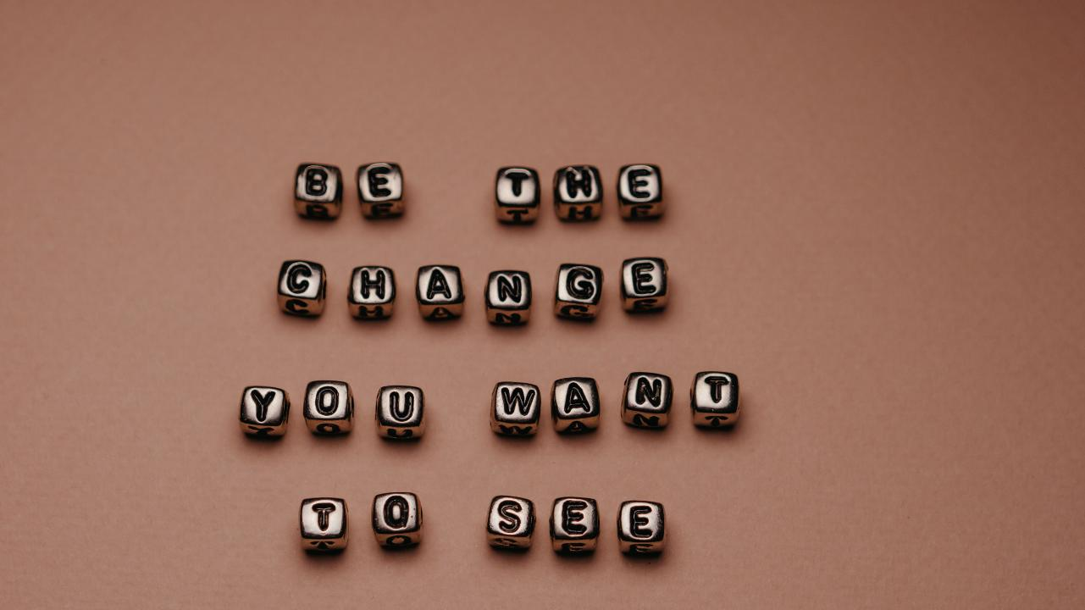

Slide 82
Notes:
Photo by engin akyurt on Unsplash
Living with it
What kind of impact does it have on my life?

Slide 83


Slide 84

Notes:
Photo by RDNE Stock project: https://www.pexels.com/photo/businessmen-holding-coffee-while-having-conversation-8124226/
Tell someone at least one person you TRUST

Slide 85
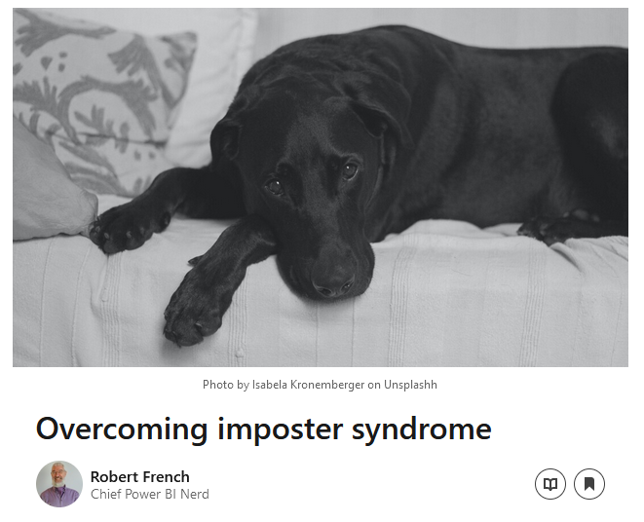
Notes:
I was amazed at the response!

Slide 86
“That’s how I feel….”
Notes:
This is what people said to me, then they read the article I was not alone in feeling that way.

Slide 87

Notes:
Photo by Ralph Katieb on Unsplash
I had to learn that I’m unique and different not quite like anyone else

Slide 88
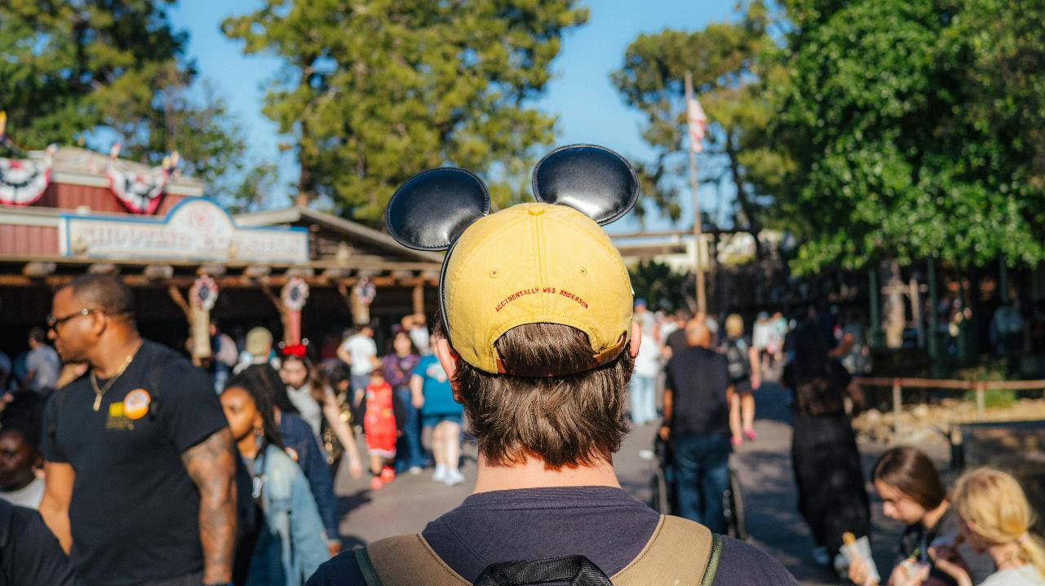
Notes:
Photo by Harry Tucker: https://www.pexels.com/photo/back-view-of-visitor-wearing-mickey-ears-at-disneyland-28561866/
Learned over time that I’m not like everyone else, I’m unique and that’s ok

Slide 89

Notes:
Photo by Guillaume de Germain on Unsplash
Being unique, different and accepting it can be a super power

Slide 90

Notes:
Photo by Pixabay: https://www.pexels.com/photo/books-in-black-wooden-book-shelf-159711/
Going to talk about creating a library of facts

Slide 91
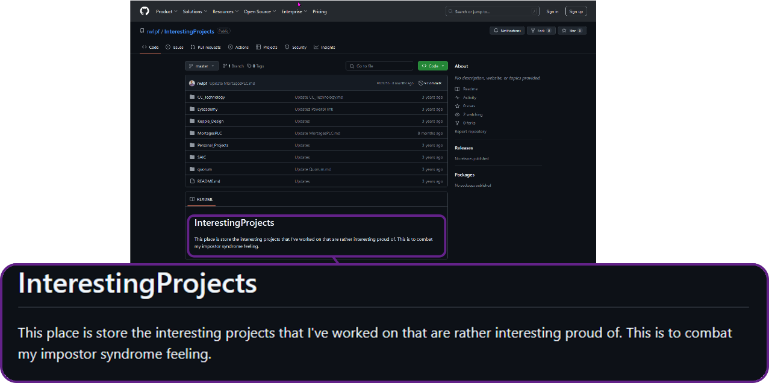

Slide 92

Notes:
Photo by Ann H: https://www.pexels.com/photo/white-text-on-white-background-15368257/
So why do this ?

Slide 93

Notes:
Photo by Hartono Creative Studio on Unsplash
Its easy to let you negative emotions and self talk influence you in the wrong way

Slide 94

Notes:
Photo by Tingey Injury Law Firm on Unsplash
Want to rebalance the scales

Slide 95
Facts
Notes:
I cannot argue with Facts they are real
Sometimes I forget what I have done
These facts when I read them remind me of what did.

Slide 96

Notes:
What I include

Slide 97
One of my passions outside of technology is cycling, and this has led to an interest in the Tour de France, one of the most recognisable professional cycle races in the world. Some datasets list the winners and times. That said, these do not include all the finishers for each stage of the race; typically, they only have the top 10 finishers and results.
While looking at various websites, I found https://www.procyclingstats.com, which lists all the finishers for each stage going back to the first race. The next step was to choose the right web scraping technology to extract the results. After careful consideration, I settled on using Python and Beautiful Soup to scrape the website. The data scraped from the website is then written to a set of tables hosted in an SQL server database.
Project Title –
Web Scraping Tour De France results
Notes:
This is an

Slide 98

Notes:
Photo by Tim Gouw on Unsplash
Was it easy to build the library of facts?
No it was not

Slide 99

Notes:
Photo by Jill Wellington: https://www.pexels.com/photo/silhouette-photography-of-jump-shot-of-two-persons-40815/
It was worth the effort

Slide 100

Notes:
Photo by CHUTTERSNAP on Unsplash
T

Slide 101
Failure
Notes:
Photo by CHUTTERSNAP on Unsplash
Dealing with failure has been part of my journey

Slide 102

Notes:
TBH I do not like to fail just ask anyone who works or lives with me

Slide 103

Notes:
Photo by Andrea Piacquadio: https://www.pexels.com/photo/man-in-pink-dress-shirt-3777568/
I get angry when I make a mistake !

Slide 104

Notes:
Photo by Pixabay: https://www.pexels.com/photo/letter-blocks-247819/
What I have learned

Slide 105

Notes:
Photo by Max van den Oetelaar on Unsplash
I'm learning to breath....

Slide 106
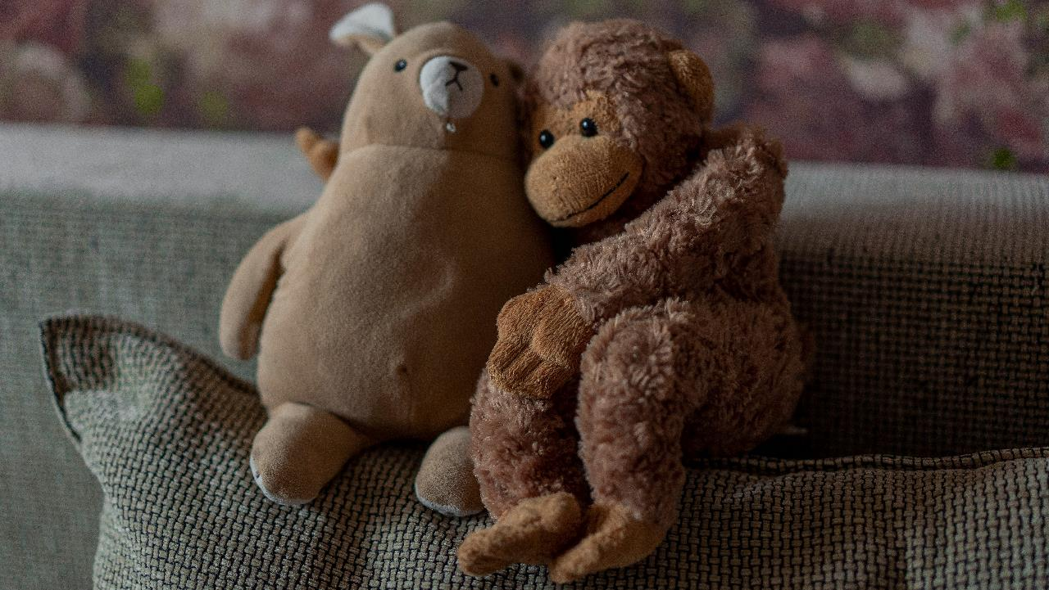
Notes:
Photo by Anastasiia Krutota on Unsplash
First thing is to be kind to myself, thing can and do fail

Slide 107
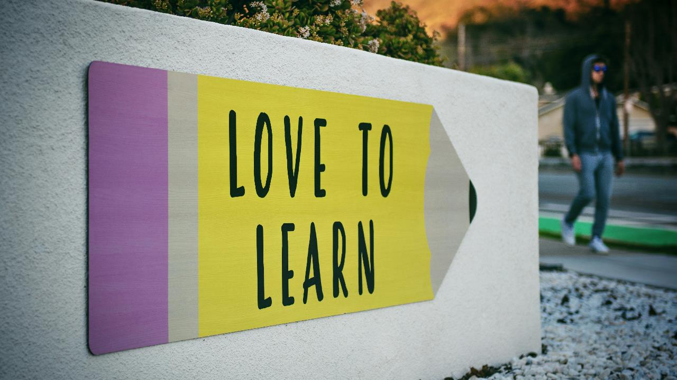
Notes:
Photo by Tim Mossholder on Unsplash
Learn from the situation – what can I learn?

Slide 108
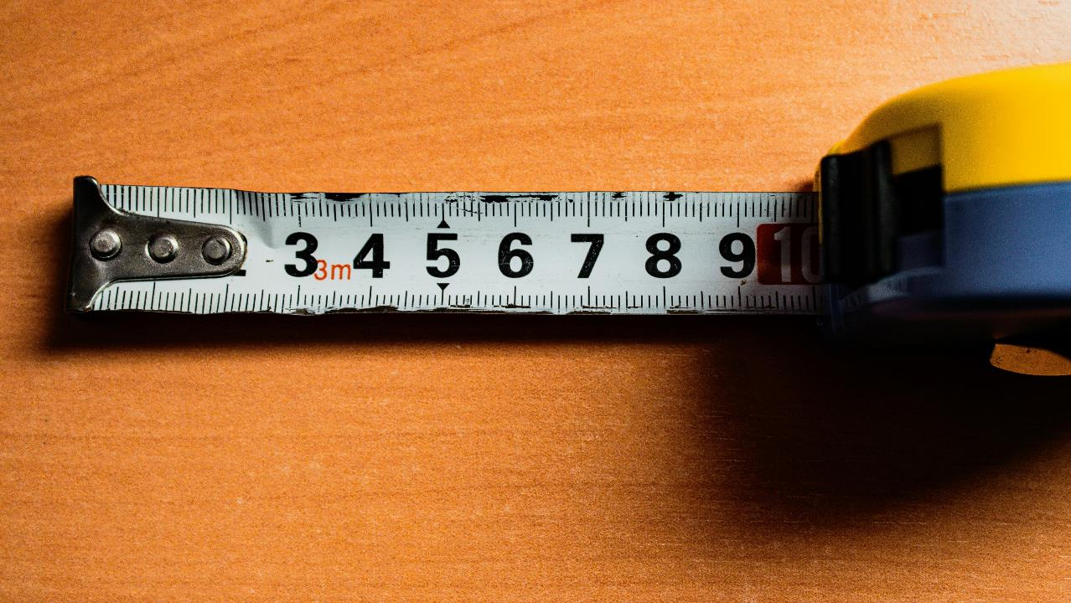
Notes:
Photo by Mark Wilkinson Hughes on Unsplash
I’m not measured or judged by my mistakes

Slide 110
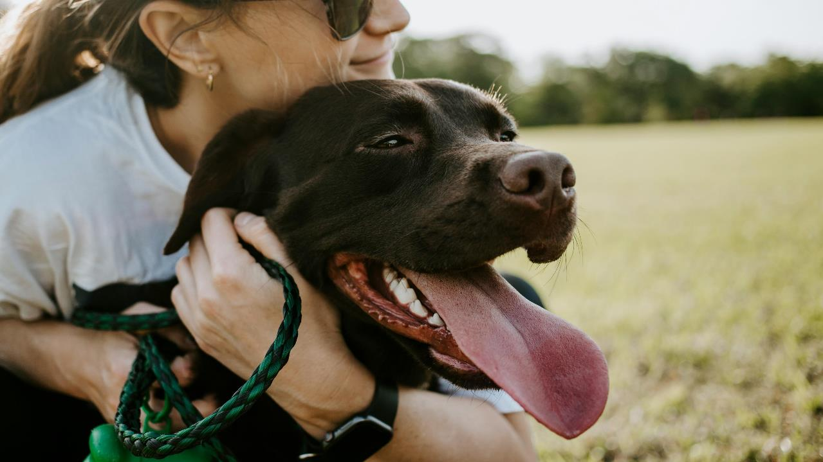
Notes:
Photo by Wade Austin Ellis on Unsplash
What would you best friend say to you if you made a mistake?
Say that then repeat

Slide 111
Compliments

Slide 112
Compliment
a remark that expresses approval, admiration, or respect:
Notes:
Lets start off defining it
We all know when we hear one, or even better when we get one

Slide 113

Notes:
This is a very fair question
There is no reason why we should do something unless we know what getting out it

Slide 114
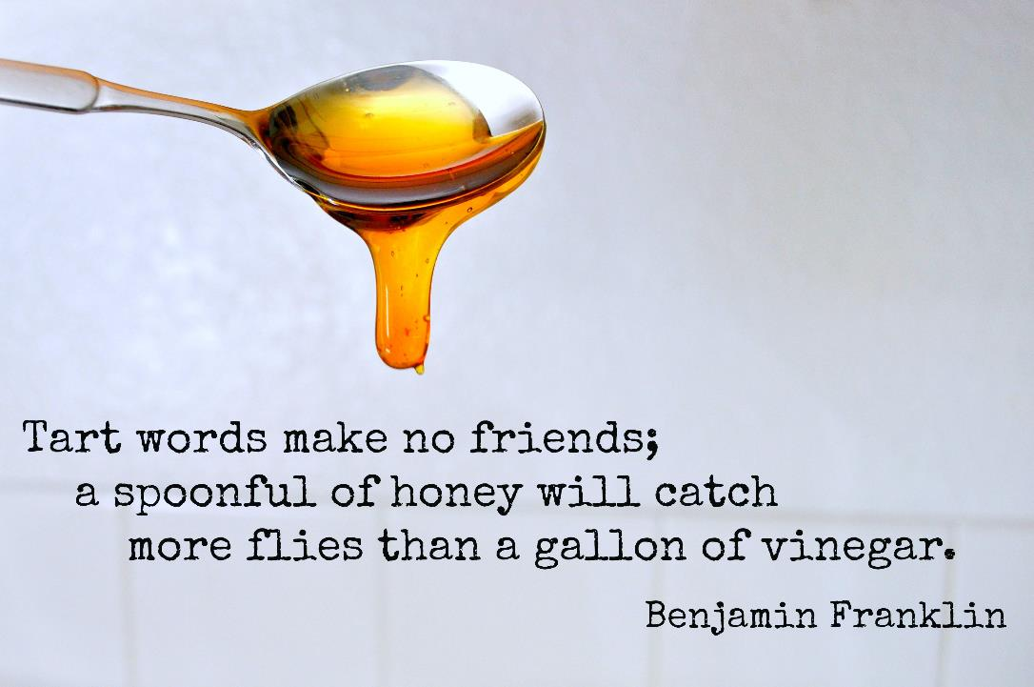

Slide 115

Source
Notes:
Compliments can boost peoples self confidience

Slide 116
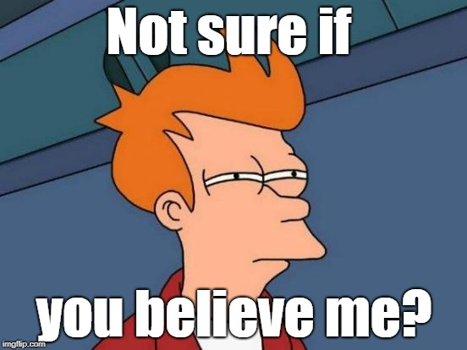
Notes:
Maybe some people do not believe me yet?

Slide 117

Notes:
Think about a compliment you received
How did it make you feel?
How did feel for the next couple of minutes / hour/ day

Slide 118

Notes:
It does and can make a difference to how you feel
https://www.flickr.com/photos/pantera-rosa/5926389312/in/photolist-a2Gi55-pMv2Z9-g3Dqwo-bttZkC-fWXbQC-KmCgh-5nMg9D-9q45GN-ak3yBH-nG8SYw-e4X2Qa-CiRb5o-shFvPt-qKtuyS-Tq3cNZ-nfUXYP-8WPEu6-78tWEj-efzET5-5jwS9n-mXzE56-csneAy-b75XAz-di5Aaz-waYVoR-eMFe1K-Lx45v-72BDhm-rYwSLx-8gQKrf-28TNDf-6huoZU-ZkPyQA-7q9CSD-WB4LAY-6nuioZ-dPPjW8-26Q4Mev-ng1t1C-9YxS1D-6AwU3o-dkEymU-7Hynhx-dc9EWW-jMwwSa-ourUSe-JwGZNs-ovdRWj-71igLv-6Ct16X

Slide 119
Do
It
Yourself
Notes:
Now I’ve told you why you should do it
Let me talk about some of things I do

Slide 120
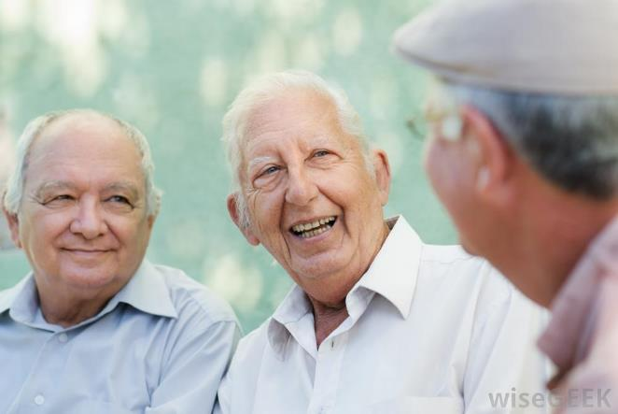
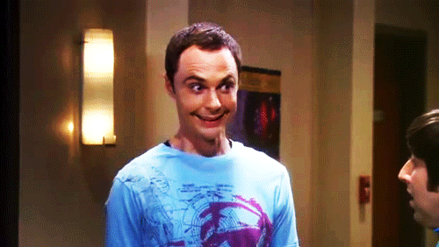
Notes:
When appropriate I will make eye contact and smile at someone when I give a compliment
They know its directed a them
2) My focus is on them

Slide 121

Notes:
Be specific with the compliment not general
Not “you look nice”
Compliment something they have rather than physical appearance unless you other half which is very different
Did they complete a physical task ?
Did they do something well eg tackling a difficult technical challaning

Slide 122
Be genuine
Notes:
If you see something that you feel should be complemented
Do not wait make the complement

Slide 123

Notes:
Use peoples name, especially if you do not know them
Peoples names are very powerful your compliment is directed at THEM

Slide 124


Slide 125

Notes:
Be on the look out for things to compliment
The more you look for them the easier it is to find them

Slide 126
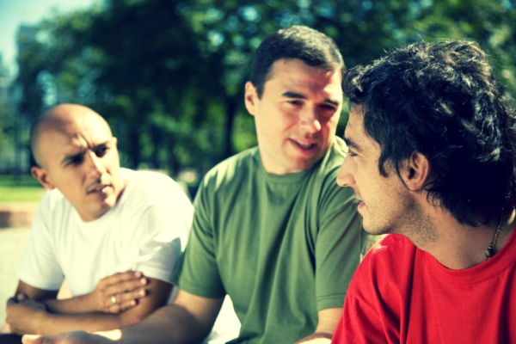
Notes:
If you heard a compliment 2nd hand
PASS IT ON, you get the credit and the recipient feels good
Win – Win situation

Slide 127


Slide 128
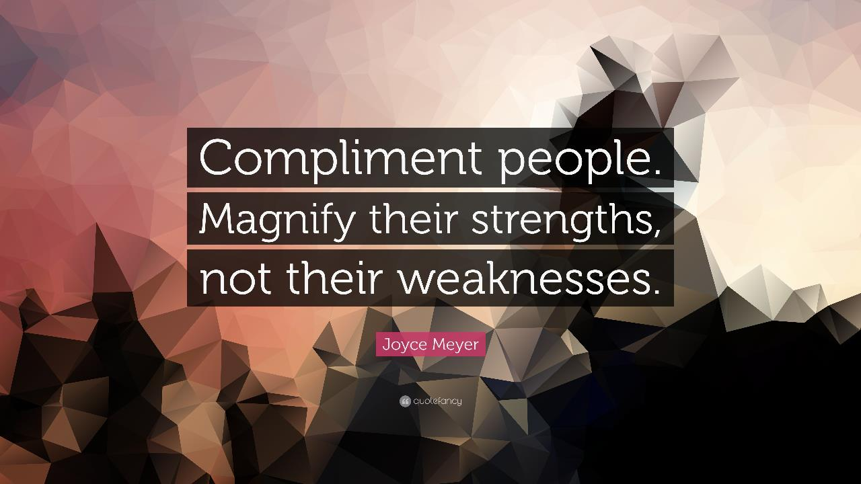

Slide 129

Notes:
How not to give compliements

Slide 130
You’re pretty good at programming
for a ……………

Slide 131

That’s a good query for someone who does not know X

Slide 132

Will the other person feel good?
Notes:
If you comment does not make the other person feel better do not say it

Slide 133

Notes:
Photo by Andrea Piacquadio: https://www.pexels.com/photo/desperate-evicted-male-entrepreneur-standing-near-window-3771129/

Slide 134

Notes:
Jut like Columbo with the famous catch phrase “just one more thing”

Slide 135

Notes:
Photo by Kat von Wood on Unsplash
At the end of a previous session someone said

Slide 136
“…it's just the Dunning Kruger effect ?...”
Notes:
This is what people said to me, then they read the article I was not alone in feeling that way.

Slide 139

Notes:
Photo by Naeem Ad on Unsplash
You might have come across people like this before? They talk like they know everything, have all the buzzwords. Yet when ask them detailed questions you realise they do not know was much as they thing.

Slide 140
Those with imposter syndrome
Every can see they know their stuff
They will deny it…..

Slide 141

Notes:
Photo by Vitaly Gariev on Unsplash
Where as those people with imposter syndrome will seem less confident but provide a detailed comphensive answer when pushed

Slide 142
Notes:
They will insist that they are just there by luck
There is nothing very special about them
Despite their abilities and talent that we can see

Slide 143


Slide 144
Notes:
Photo by Pixabay: https://www.pexels.com/photo/dictionary-text-in-bokeh-effect-267669/
Lets define it

Slide 146
Notes:
https://www.flickr.com/photos/joysaphine/2445439236
Dealing with Bull Shit Bob

Slide 147
Notes:
Photo by engin akyurt on Unsplash
Living with it
What kind of impact does it have on my life?

Slide 149
Notes:
Photo by Ralph Katieb on Unsplash
I had to learn that I’m unique and different not quite like anyone else

Slide 150
Notes:
Photo by Pixabay: https://www.pexels.com/photo/books-in-black-wooden-book-shelf-159711/
Going to talk about creating a library of facts

Slide 151
Failure
Notes:
Photo by CHUTTERSNAP on Unsplash
Dealing with failure has been part of my journey

Slide 152

Notes:
Photo by olia danilevich: https://www.pexels.com/photo/confetti-on-a-piece-of-paper-8127308/

Slide 153
Notes:
Photo by Pixabay: https://www.pexels.com/photo/letter-blocks-247819/

Slide 154
Find out more

Slide 155

Notes:
By https://regimentalpens.co.uk/products/airborne-delivery-wing, Fair use, https://en.wikipedia.org/w/index.php?curid=58910099

Slide 156

Notes:
https://quotefancy.com/media/wallpaper/3840x2160/2183754-Edmund-Burke-Quote-When-you-fear-something-learn-as-much-about-it.jpg

Slide 157

Notes:
Photo by Dominik Dancs on Unsplash

Slide 158

bit.ly/4gJ9JGu

Slide 159


Slide 160

Event feedback QR code:

Slide 161


Slide 162
Robert French
Chief Power BI Nerd with ANS Group
Lives in Sunny Glasgow, Scotland
rwlp.french@gmail.com
@sqlbobscot
https://www.linkedin.com/in/rwlpfrench/
https://www.ans.co.uk/

Slide 163

Notes:
Photo by Chris Porter on Unsplash

Slide 164

Notes:
Photo by Dan Meyers on Unsplash

Slide 165

Notes:
https://www.flickr.com/photos/terrio/12608344674/

